Slide 1
PRESENTATION OUTLINE
Pump Terminology
Pump Classification:
- Reciprocating Pumps
- Rotary Pumps
- Centrifugal Pumps
Pumping Problems
Power and Efficiency Calculations
Pump Selection

Slide 2
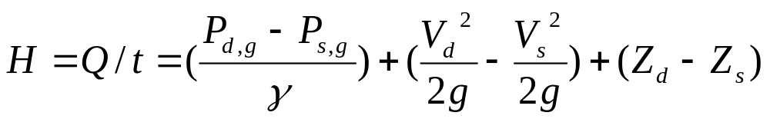
PUMP TERMINOLOGY
Pumping, the addition of energy to a fluid
Pumping action creates a partial vacuum while atmospheric pressure forces liquid up.
Pump performance, specified in terms of Q and H:
Notes:
Terminology

Slide 3
Displacement, the discharge of a fluid from a vessel
Centrifugal Force, used to produce kinetic energy

Slide 4
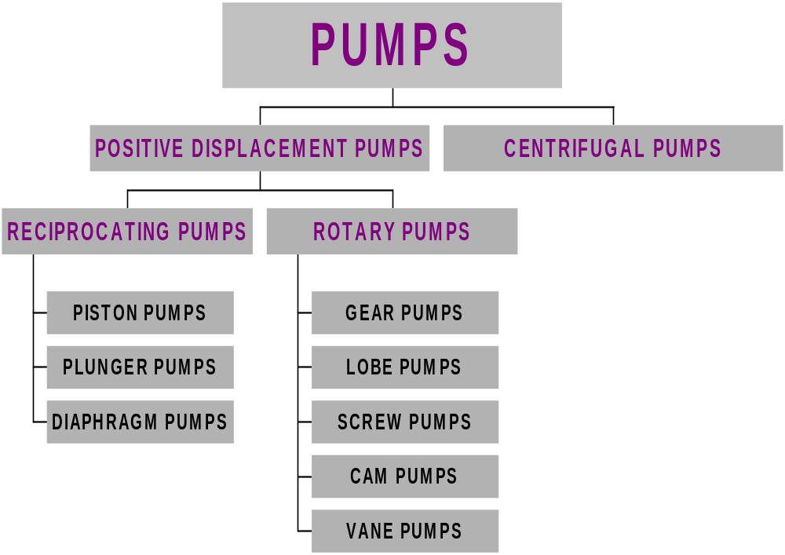

Slide 5
RECIPROCATING PUMPS
Based on two stroke principles:
√ High pressure, high efficiency
√ Self-priming
X Small quantity, vibration, physical dimension, uneven flow
Used mainly for handling slurries in plant processes and pipeline applications

Slide 6
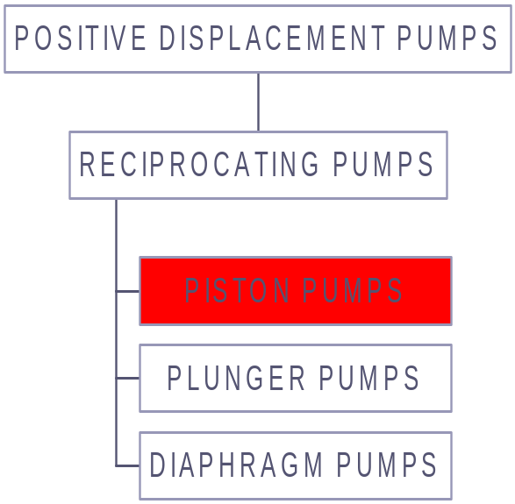
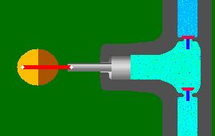
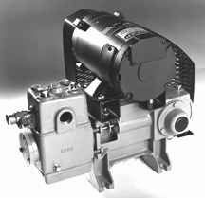
Two valves and one stuffing box
A rotating mechanism for the reciprocating piston
Uses suction to raise liquid into the chamber.

Slide 7
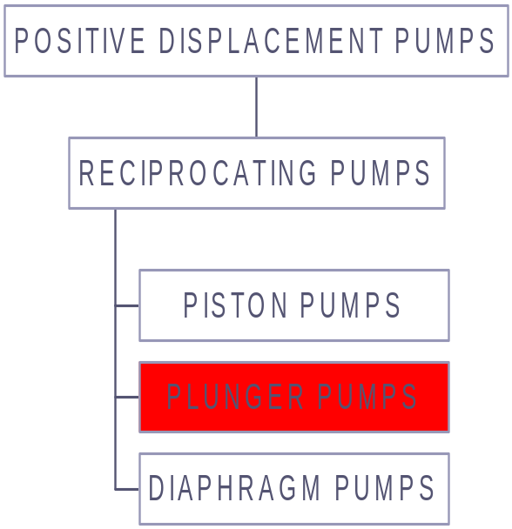
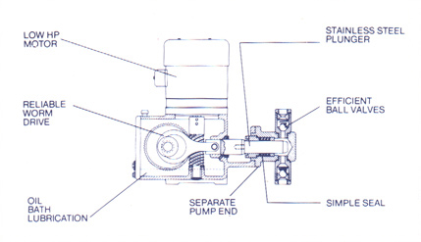
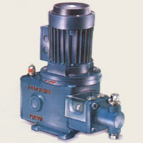
Two ball check valves on each side
Low pressure on the upward part, high pressure on the downward part

Slide 8
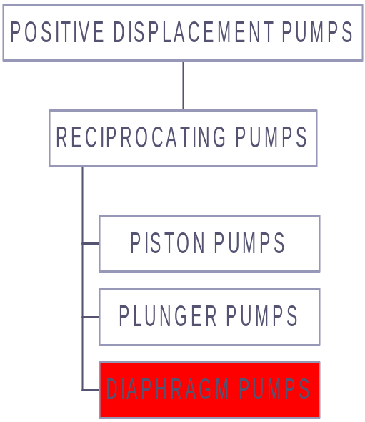
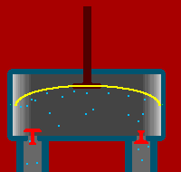
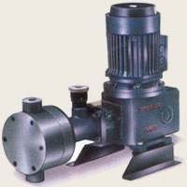
Rod is moved to push and pull the diaphragm.
Can be used to make artificial hearts.

Slide 9
ROTARY PUMPS
Positive displacement type
High pressure, high efficiency
Liquids must be free of solids
Handle viscous fluids
Used mainly in, oil burners, soaps and cosmetics, sugars, syrup, and molasses, dyes, ink, bleaches, vegetable and mineral oils

Slide 10
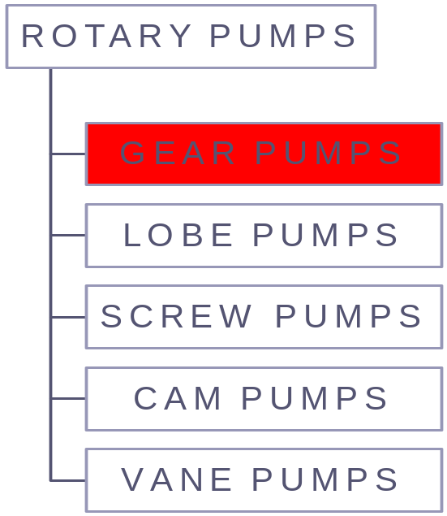
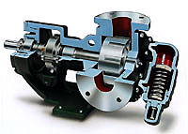

Gears create voids as they come out of mesh and liquid flows into the cavities
As the gears come back into mesh, the volume is reduced and the liquid is forced out of the discharge port

Slide 11

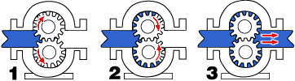
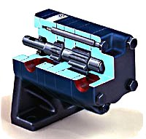
As the teeth come out of mesh, liquid flows into the pump and is carried between the teeth and the casing to the discharge side of the pump
The teeth come back into mesh and the liquid is forced out the discharge port

Slide 12
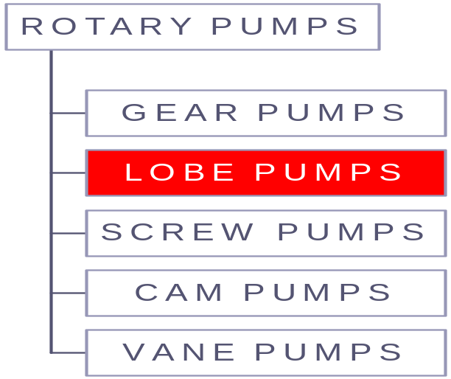
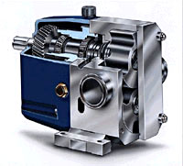

Fluid is carried between the rotor teeth and the pumping chamber
The rotor surfaces create continuous sealing
Rotors include bi-wing, tri-lobe, and multi-lobe configurations

Slide 13
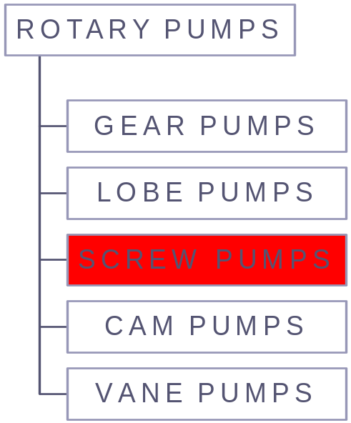
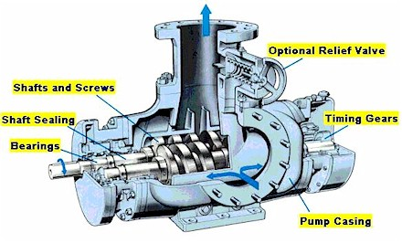
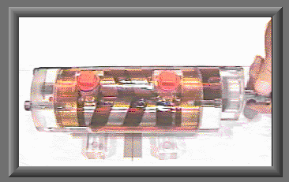
Screw pumps carry fluid in the spaces between the screw threads.
The fluid is displaced axially as the screws mesh.

Slide 14
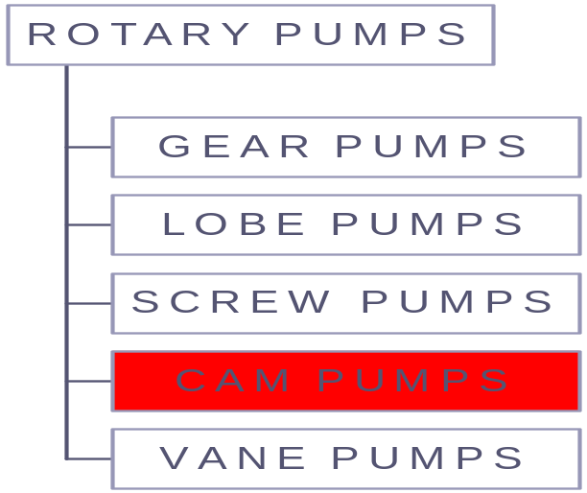

Piston slide arm moves around inside a slot in the casing.
An eccentric cam rotates the circular plunger (shown in gray) around the edge of the casing, fluid is swirled around the edge to the outlet port.
It is not in use now and is mainly of historical curiosity.

Slide 15
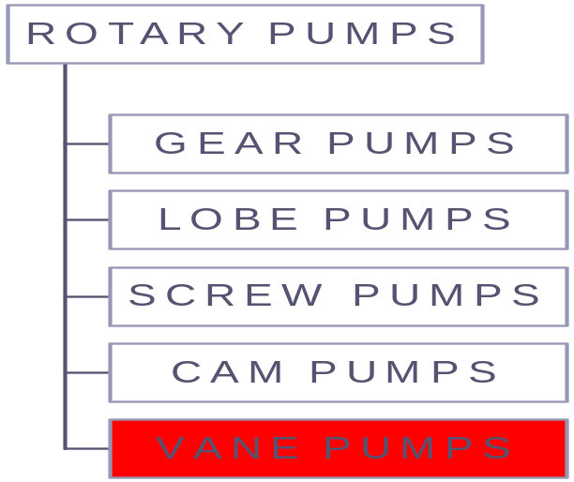
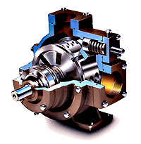
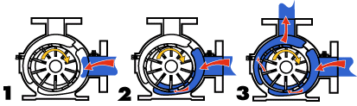
The vanes are in slots in the rotor.
Rotor spins, centrifugal force pushes the vanes out to touch the casing, where they trap and propel fluid.

Slide 16
CENTRIFUGAL PUMPS
WHAT IS CENTRIFUGAL PUMP?
WORKING MECHANISM OF A CENTRIFUGAL PUMP
ADVANTEGAES AND DISADVANTAGES OF CENTRIFUGAL PUMPS

Slide 17
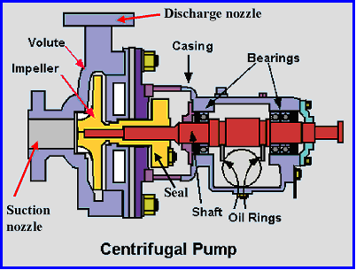
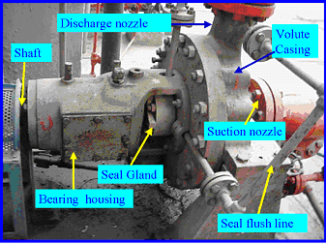
WHAT IS CENTRIFUGAL PUMP?
Convert the mechanical energy into hydraulic energy by centrifugal force on the liquid
Constitute the most common type of pumping machinery
Used to move liquids through a piping system
Has two main components:
1. Stationary componets, casing, casing cover and bearings
2. Rotating components, impeller and shaft
Classified into three categories ; Radial Flow, Mixed Flow, Axial Flow

Slide 18
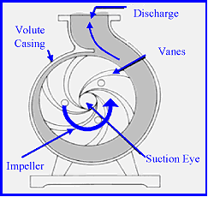
WORKING MECHANISM OF A CENTRIFUGAL PUMP
Simplest piece of equipment in any process plant
Energy changes occur by virtue of impeller and volute
Liquid is fed into the pump at the center of a rotating impeller and thrown outward by centrifugal force
The conversion of kinetic energy into pressure energy supplies the pressure difference between the suction side and delivery side of the pump
Liquid flow path inside a centrifugal pump

Slide 19
ADVANTAGES OF CENTRIGUGAL PUMPS
Advantages
Simple in construction and cheap
Handle liquid with large amounts of solids
No metal to metal fits
No valves involved in pump operation
Maintenance costs are lower

Slide 20
DISADVANTAGES OF CENTRIFUGAL PUMPS
Disadvantages
Cannot handle highly viscous fluids efficiently
Cannot be operated at high heads
Maximum efficiency holds over a narrow range of conditions

Slide 21
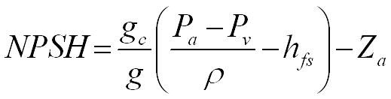
PUMPING PROBLEMS
Cavitation
Reduces the pump capacity
Causes metal removal
reduced flow
loss in efficiency
and noise
To avoid cavitation NPSH

Slide 22
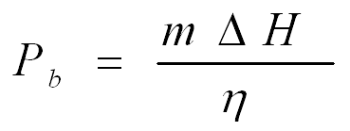
POWER AND EFFICIENCY CALCULATIONS
The power supplied to the pump:
…………(1)
Where m=mass flow rate, kg/s
ΔH= total discharge head, N.m/kg
η=efficiency

Slide 23

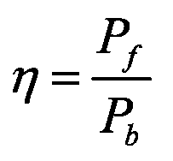
…
The power delivered to the fluid:
……………(2)
From equations (1) and (2) efficiency:

Slide 24
PUMP SELECTION
The amount of fluid
The properties of the fluid
Type of power supply
Cost and mechanical efficiency of the pump

Slide 25
CAPACITY
PRESSURE
SMALL OR MODERATE
MODERATEOR HIGH
LOW
HIGH
HIGHER
GEAR
LOBE CENTRIFUGAL
RECIPROCATING or
RIGID SCREW
ROTARY PLUNGER
or
ROTARY PISTON

Slide 26
REFERENCES
http://en.wikipedia.org/wiki/Pump
www.cheresources.com
www.pumpworld.com/contents.htm
www.rpi.edu./dept/chem-eng/ Biotech-Environ/PUMPS/intro.html

Slide 27

Thanks

